Slide 1
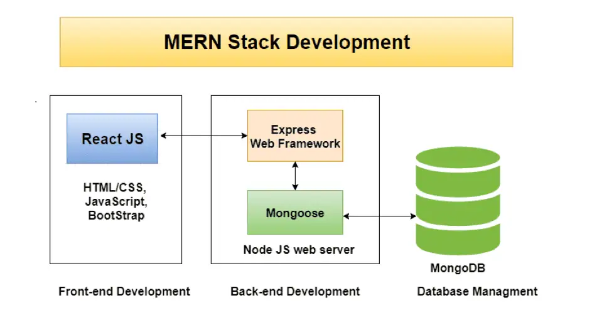
High Level Architecture - from the Internet

Slide 2




High Level Architecture – How I see it
Client
frontend
Browser
Server
backend
DB

Slide 3
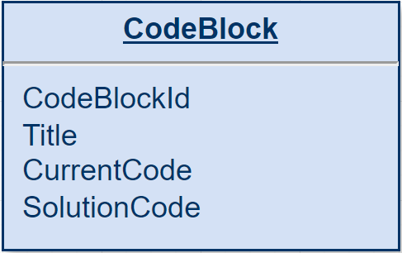
ERD – Entity Relationship diagram

Slide 4
User Interface

Slide 5
Lobby page
Choose code block
List of at least 4 codeblocks pages

Slide 6
Code Block page
Attributes:
role - mentor/student
Num of participants
Code block name
Back to the main page
Text editor - Code block itself

